Slide 1
DE Assignment#1-Q#1
PREPARED BY: IBRAHIM SHAHBAZ

Slide 2
Setting up the NIFI Environment
Follow the instructions in the ReadMe file to perform the following:
Run the Nifi application through the Docker compose file
Place the CSV file (covid19.csv) into the mounted input folder

Slide 3

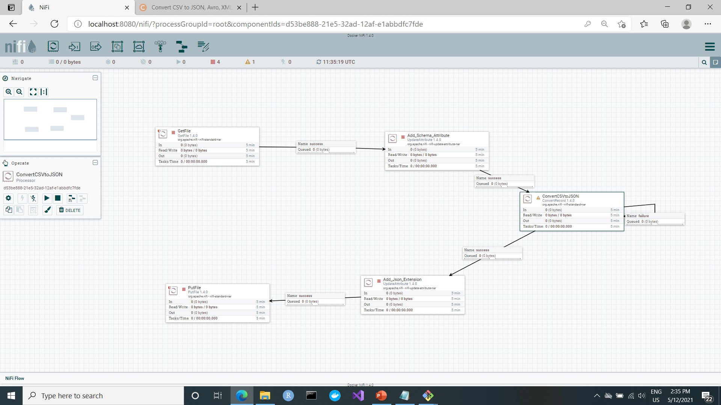
First Look at the Proposed Workflow
UpdateAttribute processes
ConvertRecord processe

Slide 4
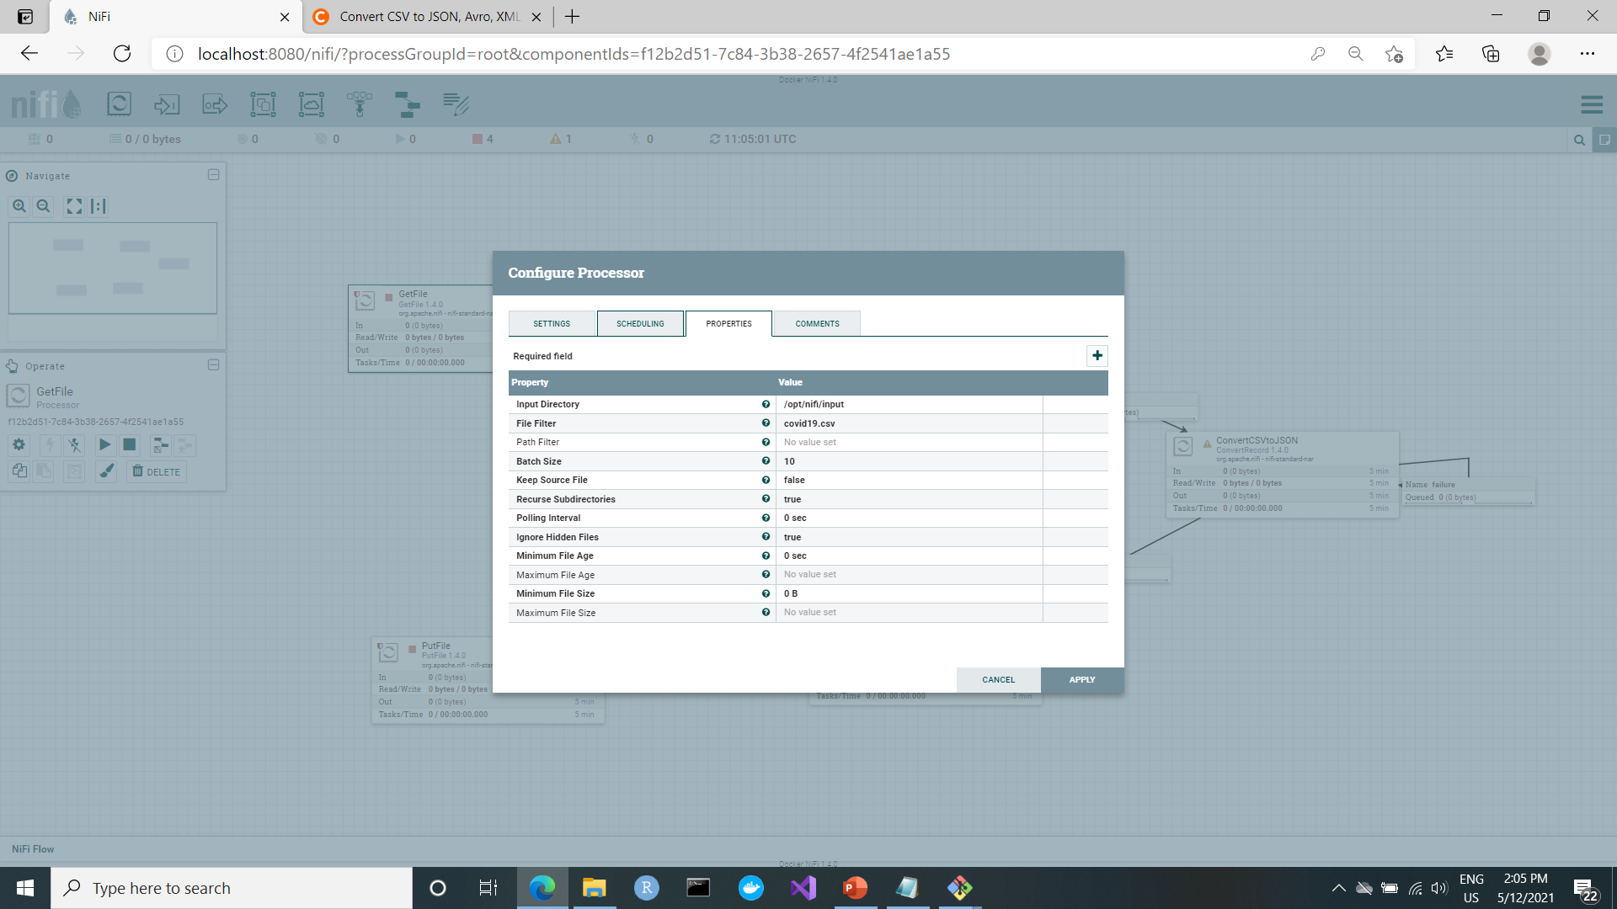
GetFile node
Set the input directory and the file name to filter for

Slide 5
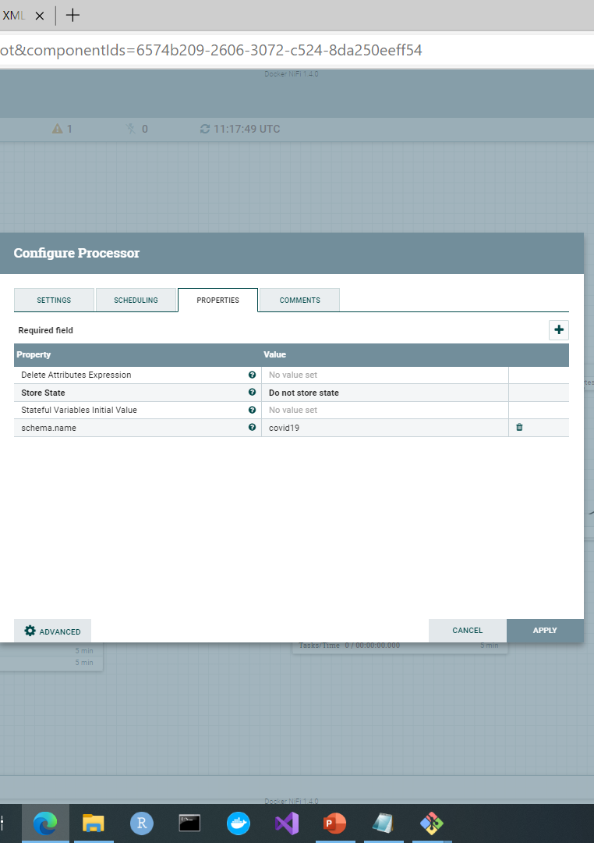
Add_Schema_Attribute node
Add Schema Name “covid19" as an attribute to the flowfile

Slide 6

ConvertCSVtoJSON node
After setting the reader and writer press one of those arrows to Go To the Controller services and create an AvroSchemaRegistry
Set the Record Reader to CSVReader & the Record Writer to JsonRecordWriter

Slide 7
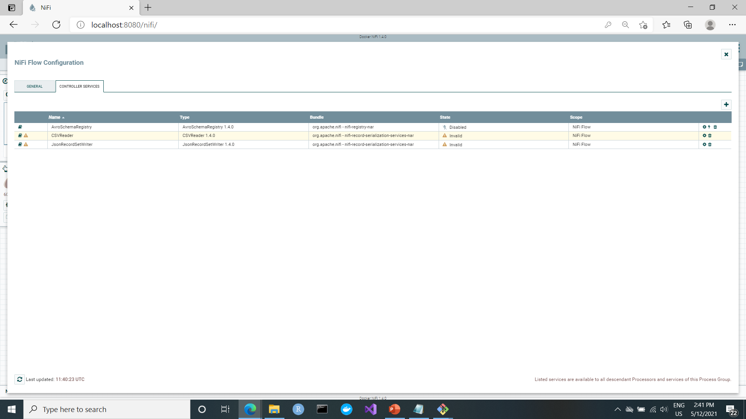
Controller Services
Press configure to create the covid19 schema

Slide 8
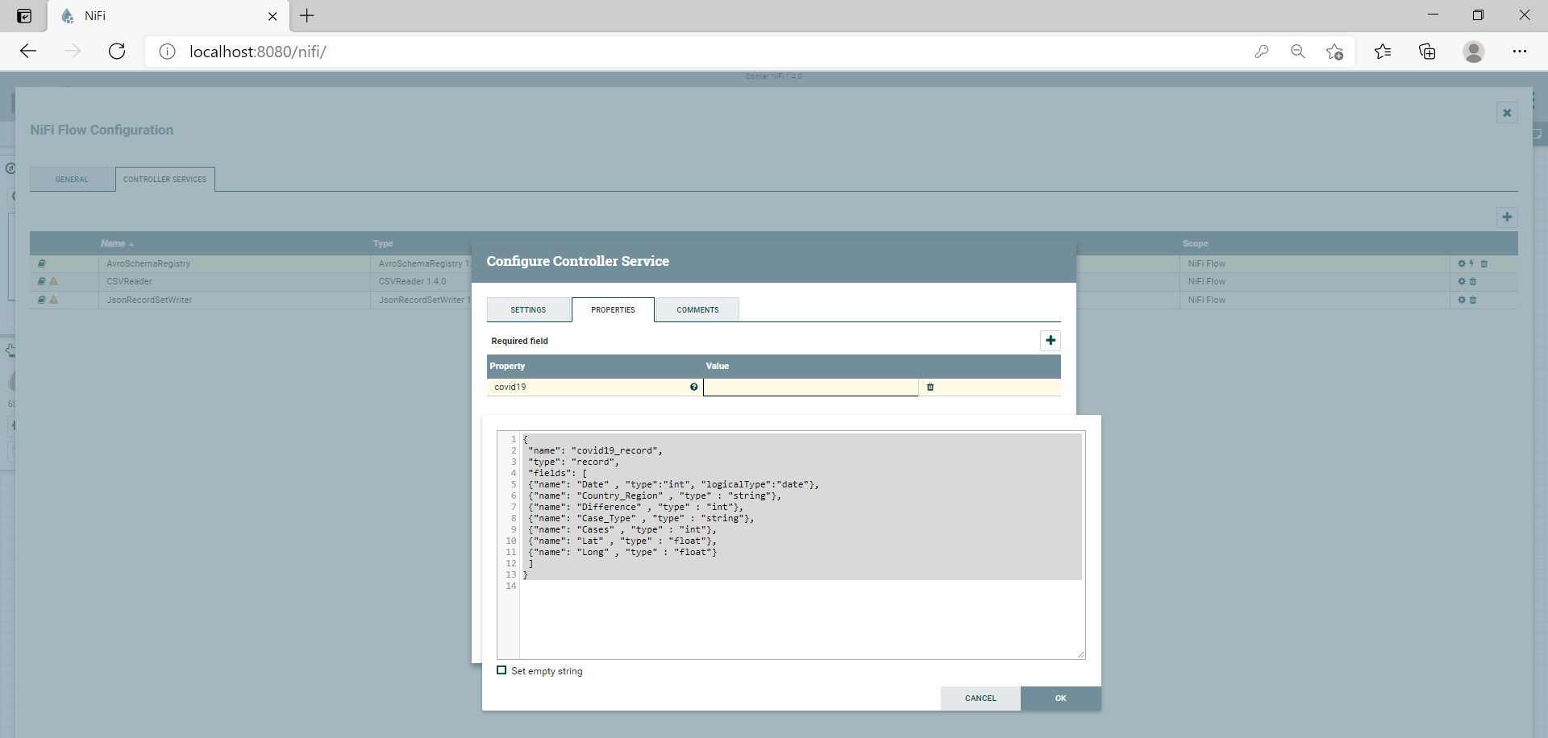
Covid19 Schema Creation
1.
Press to add new property
2.
name the property covid19
2.
Explicitly enter the required schema

Slide 9
Controller Services
Press configure to set the settings for CSVReader

Slide 10
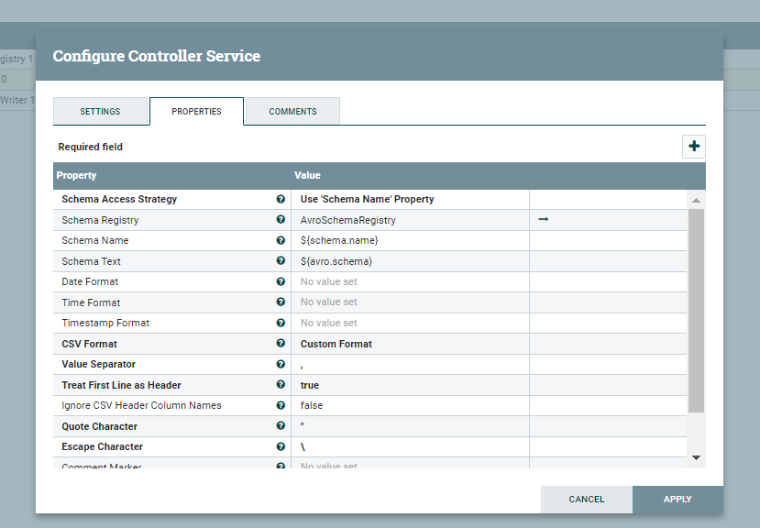
CSVReader Controller Settings

Slide 11
Controller Services
Press configure to set the settings for JsonRecordSetWriter

Slide 12
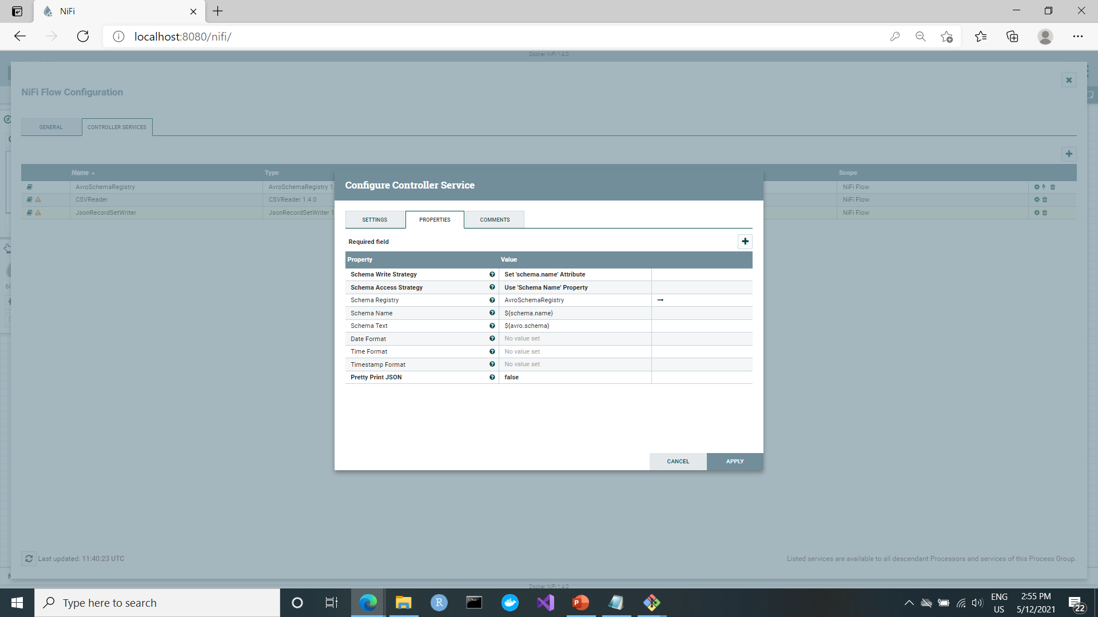
JsonRecordSetWriter Controller Settings

Slide 13
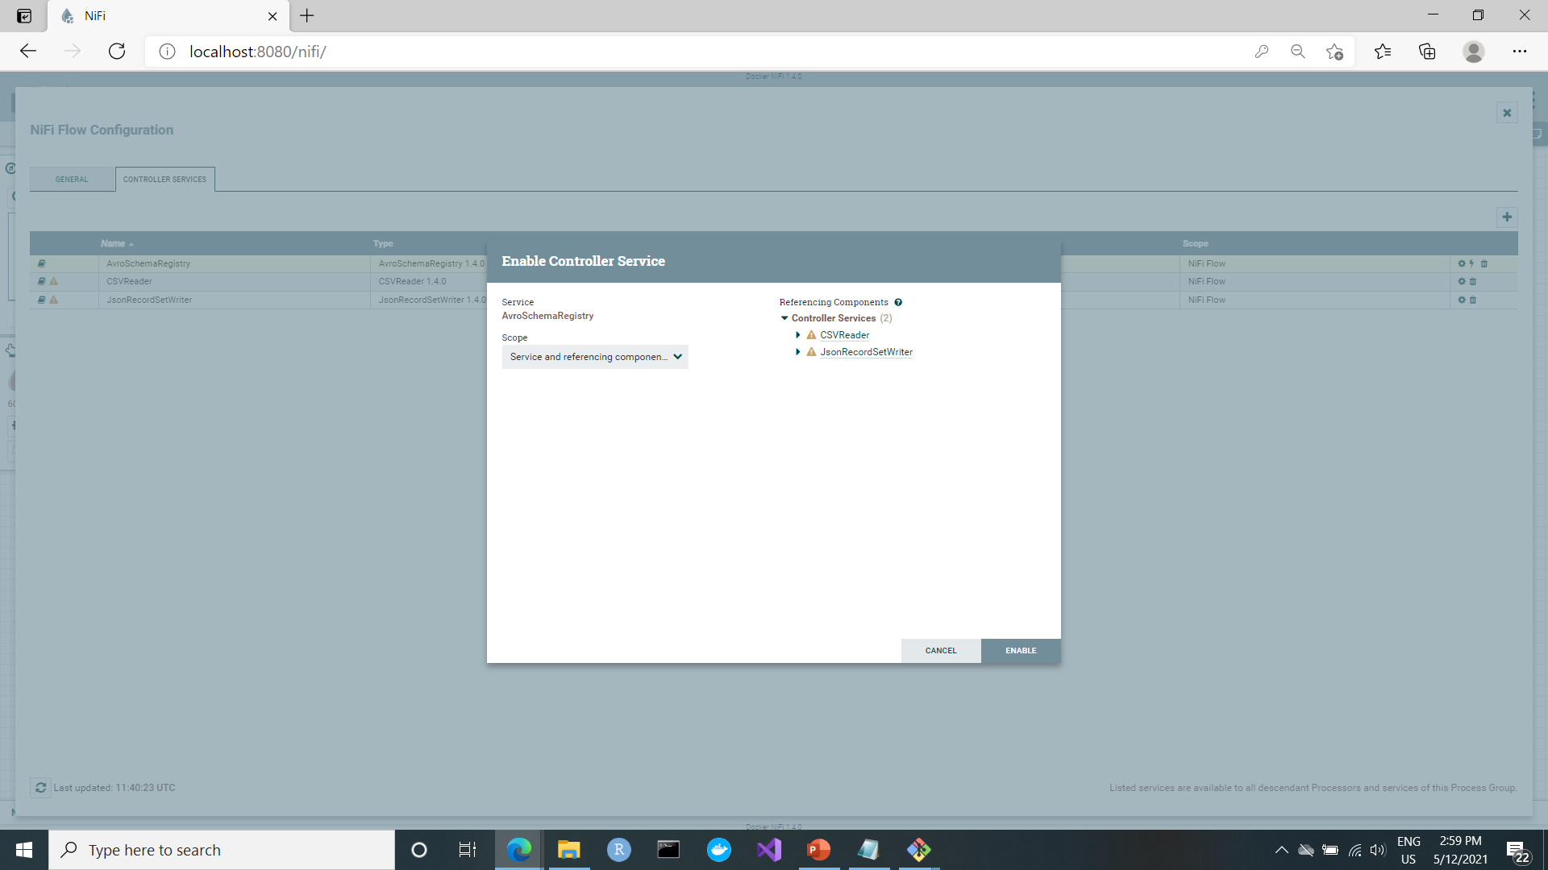
Controller Services
Now enabling the AvroSchemaRegistry which is linked to CSVReader andJsonRecordSetWriter will enable them also

Slide 14
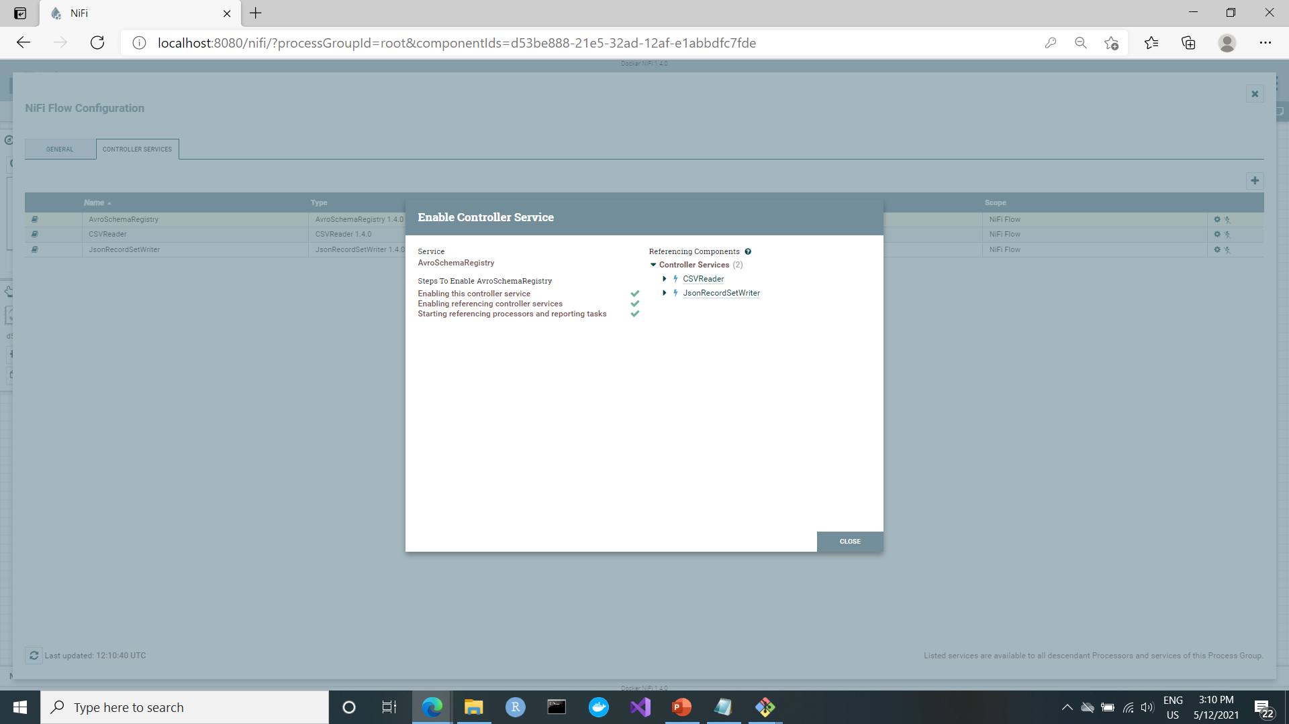

Slide 15
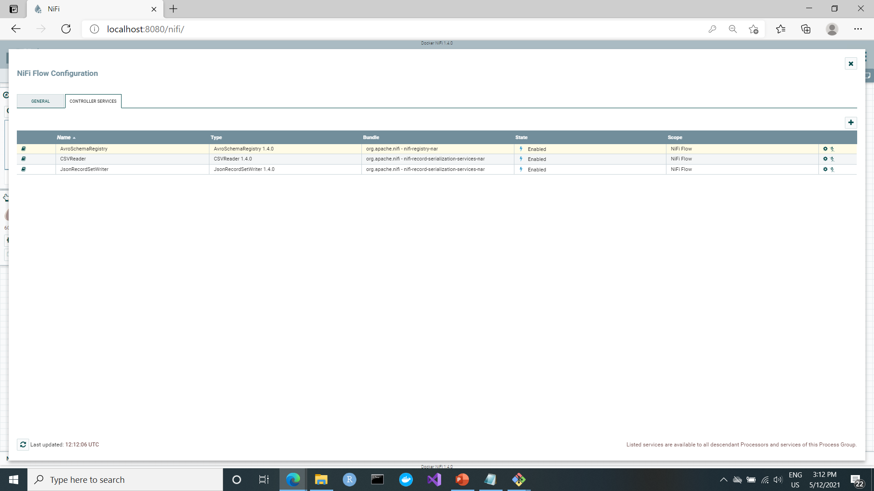

Slide 16
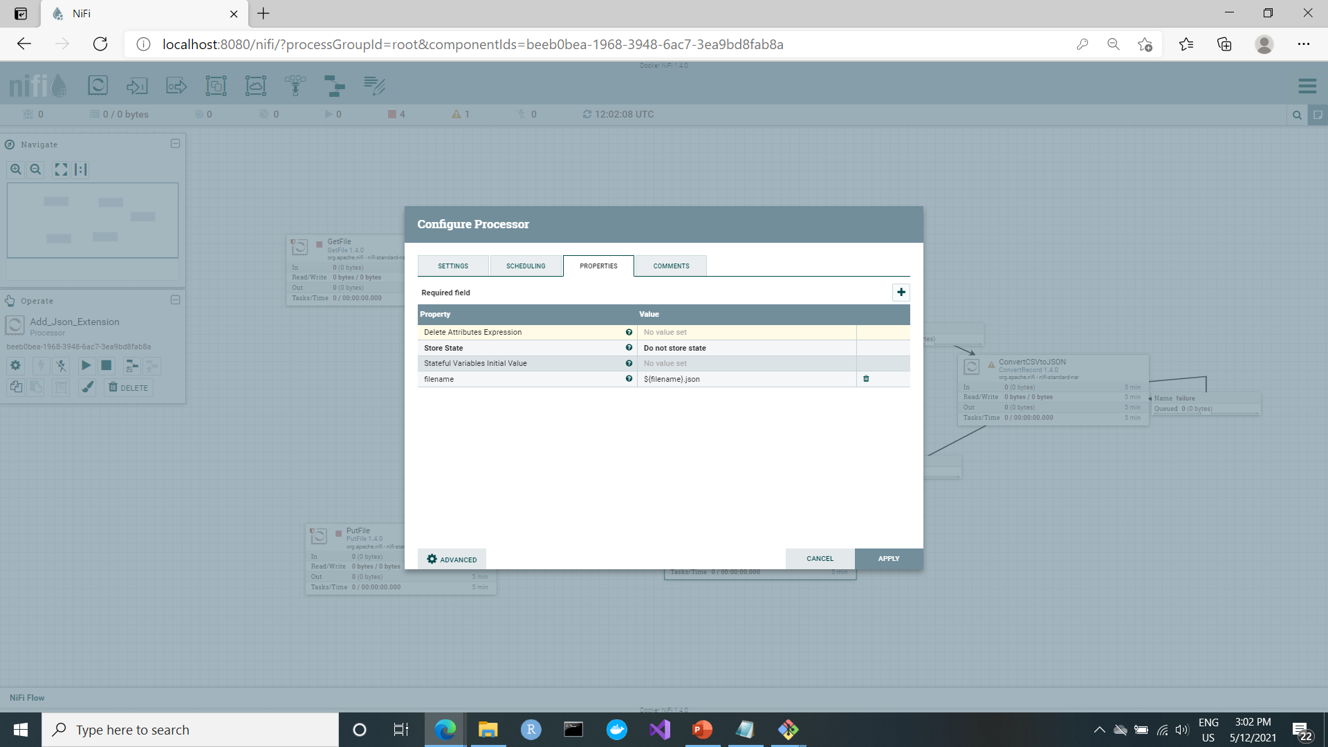
Add_Json_Extension node
Add a filename property that adds .json extension the produced file

Slide 17
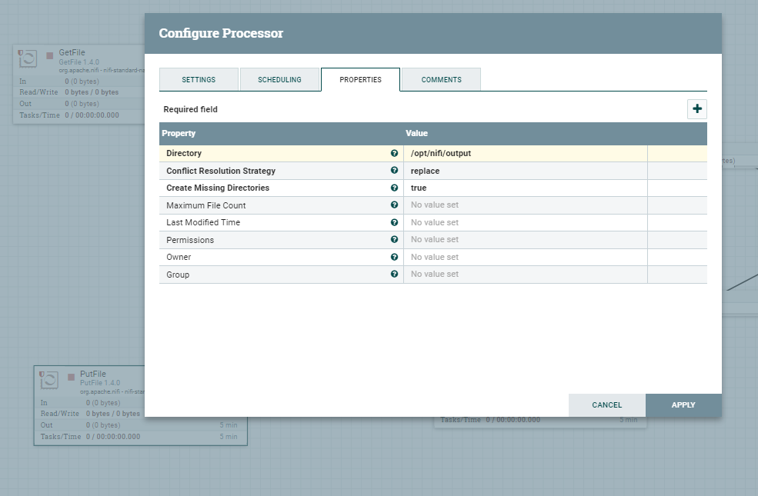
PutFile node
Set the directory to place the new Json file to the output directory created in the Nifi Docker Container

Slide 18
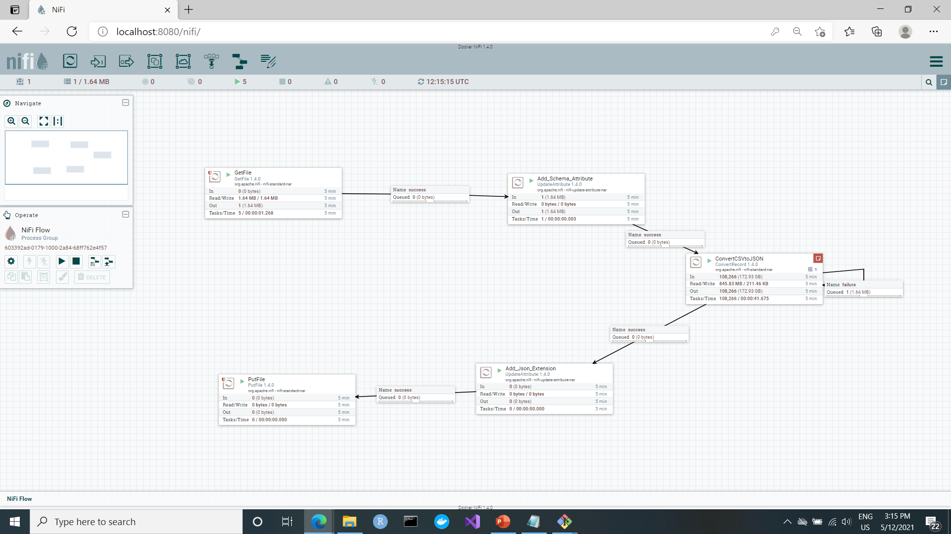
Run the Workflow
Run

